Slide 1
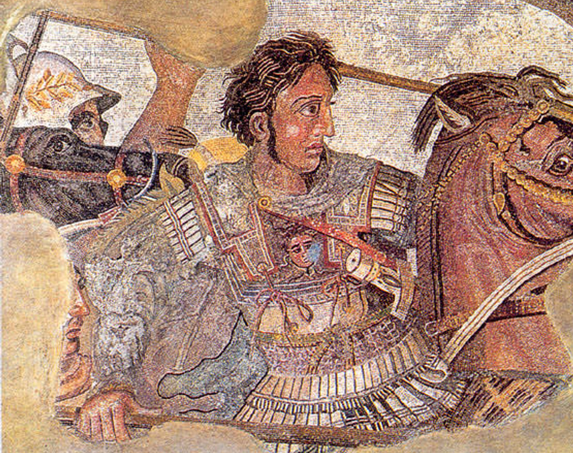
Sources for Alexander the Great
11 Ancient History

Slide 2
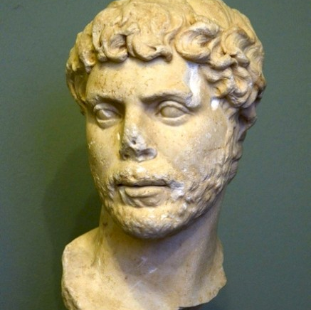
Arrian of Nicomedia
86 AD – 160 AD

Slide 3
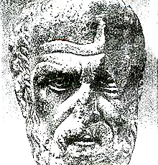
Arrian of Nicomedia
Greek historian and senator of the Roman empire, author of several historical studies. His best-known work is the Anabasis, which deals with Alexander the Great.
Despite his dazzling career in the Roman government, Arrian found time to write many books, which are generally modelled on the publications of the Athenian author Xenophon (c.430-c.354).
Arrian's Anabasis ("journey up-country") is our most important source on the reign of Alexander. The reason is that Arrian ignored Cleitarchus' immensely popular History of Alexander and used other, better sources.
It seems to me that Ptolemy and Aristobulus are the most trustworthy writers on Alexander's conquests, because the latter shared Alexander's campaigns, and the former -Ptolemy- in addition to this advantage, was himself a king, and it is more disgraceful for a king to tell lies than for anybody else.

Slide 4
Arrian’s Anabasis
Origin of the Source
Author: Arrian of Nicomedia, a Greek historian, public servant, military commander, and philosopher of the Roman period.
Date: Written in the 2nd century AD, around 130-140 AD.
Place: Likely composed in Nicomedia or possibly in Rome, where Arrian spent much of his later life.
Perspective of the Source
Viewpoint: Arrian wrote from the perspective of a Greek living under Roman rule, with a strong admiration for Alexander the Great. His background as a military commander also influenced his detailed military descriptions and strategic analysis.
Biases: Arrian’s work shows a clear admiration for Alexander the Great, potentially leading to a more favorable portrayal of Alexander’s actions and character. He aimed to present Alexander as an exemplary leader and conqueror.

Slide 5
Arrian’s Anabasis
Context of the Source
Historical Context: Written during the Roman Empire’s height, long after Alexander’s conquests (4th century BC). The Roman Empire admired Greek culture and often looked back at Alexander’s achievements with great respect.
Cultural Context: The period was marked by a resurgence of interest in Hellenistic history and culture. Roman leaders often saw themselves as heirs to Alexander’s legacy, which may have influenced Arrian’s portrayal.
Audience Intended for the Source
Target Audience: Likely educated Romans and Greeks who were interested in history, particularly military history and leadership. Arrian wrote for an audience that respected classical antiquity and was familiar with its heroes.
Influence on Content: Arrian’s audience would have expected a detailed, respectful account of Alexander’s campaigns, emphasizing military strategy, leadership, and heroism. This influenced the thoroughness and tone of his writing.
Motive of the Source
Purpose: To provide a comprehensive and accurate account of Alexander the Great’s military campaigns. Arrian intended to correct the inaccuracies and exaggerations of previous histories.
Goal: Arrian aimed to offer an authoritative history that highlighted Alexander’s military genius and leadership qualities. He sought to preserve Alexander’s legacy and provide a model of leadership for future generations.

Slide 6
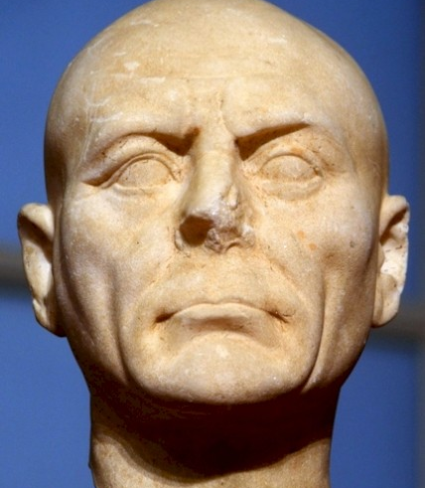
Diodorus Siculus
1st Century BCE

Slide 7
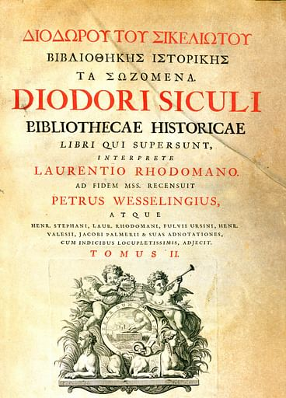
Diodorus Siculus
Diodorus Siculus, or Diodorus of Sicily, was an ancient Greek historian. He is known for writing the monumental universal history (or a history of everything) Bibliotheca historica, in forty books, fifteen of which survive intact, between 60 and 30 BC.
The first six books treated the mythic history of the non-Hellenic and Hellenic tribes to the destruction of Troy and are geographical in theme, and describe the history and culture of Ancient Egypt (book I), of Mesopotamia, India, Scythia, and Arabia (II), of North Africa (III), and of Greece and Europe (IV–VI).
In the next section (books VII–XVII), he recounts the history of the world from the Trojan War down to the death of Alexander the Great. The last section (books XVII to the end) concerns the historical events from the successors of Alexander down to either 60 BC or the beginning of Julius Caesar's Gallic Wars.

Slide 8
Diodorus of Siculus’s Bilbiotheca Historica
Origin of the Source
Author: Diodorus Siculus, a Greek historian from Agyrium in Sicily.
Date: The Bibliotheca Historica was written between 60 and 30 BC.
Place: Likely written in Rome, where Diodorus spent significant time during his career.
Perspective of the Source
Viewpoint: Diodorus wrote as a Greek historian during the Roman Republic, providing a comprehensive history of the world from mythical times up to his contemporary period. His perspective is shaped by the Hellenistic tradition and his access to earlier historical works.
Biases: Diodorus aimed to compile and synthesize the works of earlier historians. His writings on Alexander the Great may reflect the biases and interpretations of his sources, which include both admiring and critical views of Alexander.

Slide 9
Diodorus of Siculus’s Bilbiotheca Historica
Context of the Source
Historical Context: Written during the late Roman Republic, a time of great political upheaval and transition. The Roman Republic was on the cusp of becoming the Roman Empire, and there was a significant interest in historical figures who had achieved great conquests, like Alexander the Great.
Cultural Context: The Hellenistic world had a strong influence on Roman culture. Romans admired Greek culture, and Alexander the Great was often held up as a model of leadership and military prowess. Diodorus’s work reflects this cultural milieu and the blending of Greek and Roman traditions.
Audience Intended for the Source
Target Audience: Educated Greeks and Romans who were interested in world history and the deeds of great leaders. His audience would have included scholars, statesmen, and educated citizens of the Roman Republic and early Roman Empire.
Influence on Content: Diodorus’s audience expected a detailed and engaging narrative that provided both entertainment and moral lessons. His writings on Alexander aimed to meet these expectations by portraying Alexander’s achievements and character in a way that was both informative and reflective of contemporary values.
Motive of the Source
Purpose: To compile a universal history that preserves the knowledge of the past and provides moral and practical lessons for the present. Diodorus intended to create a comprehensive account that drew from various sources to provide a balanced perspective.
Goal: To educate and inform his readers about the significant events and figures of history, including the life and campaigns of Alexander the Great. By doing so, Diodorus sought to highlight the virtues and vices of historical figures, offering examples of conduct for his contemporaries.

Slide 10
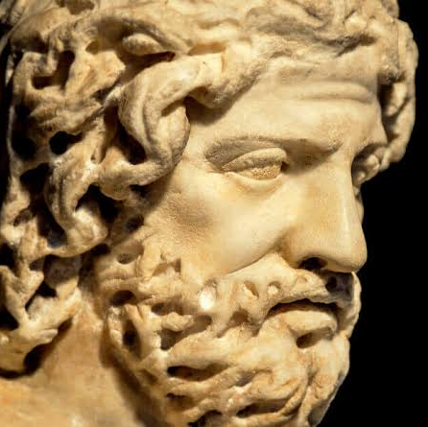
Plutarch
46 CE – approx. 119 CE

Slide 11
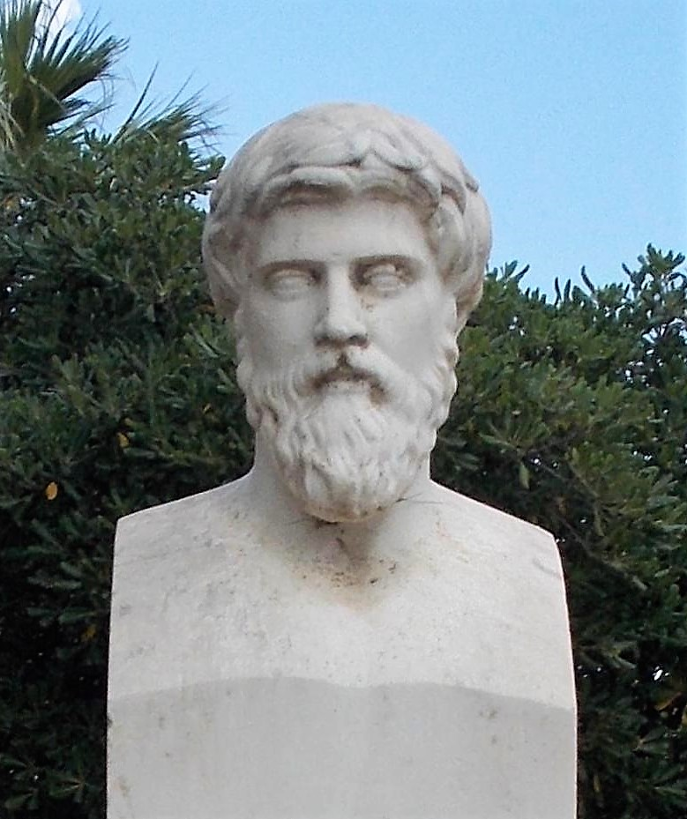
Plutarch
Plutarch (46CE-119 CE) was an ancient Greek biographer and author whose works strongly influenced the evolution of the essay, the biography, and historical writing in Europe from the 16th to the 19th century.
Among his approximately 227 works, the most important are:
The Bioi parallēloi (Parallel Lives), in which he recounts the noble deeds and characters of Greek and Roman soldiers, legislators, orators, and statesmen (including Alexander the Great)
The Moralia, or Ethica, a series of more than 60 essays on ethical, religious, physical, political, and literary topics.

Slide 12
Plutarch’s Bioi parallēloi
Origin of the Source
Author: Plutarch, a Greek biographer and essayist.
Date: Written in the late 1st century AD, around 75 AD.
Place: Likely written in Chaeronea, Plutarch's hometown in Boeotia, Greece, though Plutarch also spent significant time in Rome.
Perspective of the Source
Viewpoint: Plutarch wrote as a moralist and philosopher with a deep interest in character and ethics. His biographies were intended to provide moral lessons by comparing the lives of famous Greeks and Romans.
Biases: Plutarch's admiration for classical Greek culture and his intent to highlight moral virtues and vices influenced his portrayal of Alexander. He often focused on character traits and personal anecdotes that illustrated moral lessons.

Slide 13
Plutarch’s Bioi parallēloi
Context of the Source
Historical Context: Written during the Roman Empire, under the rule of Emperor Vespasian and his successors. This period was marked by relative stability and a renewed interest in classical Greek and Roman heritage.
Cultural Context: The Roman Empire had a profound respect for Greek culture, and figures like Alexander the Great were seen as exemplars of leadership and military genius. Plutarch's work reflects this cultural admiration and the integration of Greek and Roman traditions.
Audience Intended for the Source
Target Audience: Educated Greeks and Romans who were interested in history, philosophy, and moral instruction. His audience included scholars, statesmen, and individuals seeking ethical guidance.
Influence on Content: Plutarch’s audience expected biographies that were not only informative but also provided moral and ethical insights. His focus on personal virtues and vices was intended to offer examples of conduct for his readers.
Motive of the Source
Purpose: To provide moral instruction through the comparison of the lives of famous individuals from Greek and Roman history. Plutarch aimed to highlight the virtues and faults of these individuals to offer lessons in ethics and character.
Goal: To educate and inspire his readers by presenting the lives of great men in a way that emphasized their moral and ethical dimensions. Plutarch's portrayal of Alexander the Great aimed to showcase his virtues, such as bravery and leadership, as well as his flaws, providing a balanced view that served as a moral example.

Slide 14
Source Evaluation
The document provides three accounts of Alexander’s visit to the oracle of Zeus-Ammon (also known as Amun in earlier Egyptian culture) at Siwa, during the winter of 332/331 BCE.
Using the OPCAMs for each of these three sources, compare these accounts and evaluate them for reliability and usefulness
Using these evaluations, answer the key inquiry question “What can we learn about Alexander from his time in Egypt?”

